Slide 1

2020 SUMMER SAFETY
DURING COVID-19
UNCLASSIFIED
CRITICAL DAYS OF
SUMMER PRESENTATION

Slide 2

UNCLASSIFIED
Summer is almost upon us and it is, once again, time for the Summer Safety Campaign. The 101 Critical Days of Summer begins on Memorial Day Weekend and ends after Labor Day Weekend.
This is the largest and busiest vacation period of the year. The great weather draws people outside to enjoy swimming, boating, biking, running, and numerous other activities.
This summer will be very different then past years incorporating social distancing and precautions while engaging in activities approved by state and local governments.
Notes:
Although this year’s Critical Days of Summer are Memorial Day (29 May 2018) to Labor Day (4 September 2018) the safety topics/training covered in this presentation are applicable year-round.
The Navy and Marine Corps are global, but the vast majority of you are in the Northern Hemisphere Temperate Zone during the best time to be out in the weather from: Memorial Day to Labor Day.
These days are our Critical Days of Summer.

Slide 3
UNCLASSIFIED
GET READY…
With summer arriving, and the COVID-19 Pandemic still affecting our lives we find ourselves in a unique situation. There has been a lot of changes over the last few months and as we start to get out more, we must be cognizant of our abilities and the risks around us.
Many injuries occur each year when individuals are exercising to get into shape. Take it slow and ease into the workouts. Don’t try to squeeze 2 months of exercise into 30 days trying to make up for lost time.
Inspect your equipment that might have been sitting more than normal for this time of year. It could be a boat, jet ski, motorhome, motorcycle, bicycle, lawn equipment, or your everyday vehicle.
The best safety tip is to be prepared. Take your time, evaluate the risks and stay within your abilities.

Slide 4
UNCLASSIFIED
DON FISCAL YEAR FATALITIES
2017 THRU 2019
# of FATALITIES
https://www.public.navy.mil/NAVSAFECEN/Pages/statistics/index.asp
Notes:
.
Looking at last year’s presentation and the coinciding bar graph one would observe a shift in numbers in the various categories

Slide 5
UNCLASSIFIED
FY20 NRSW FATALITIES
Motor Vehicle Fatalities
13Feb 2020: (San Diego, Ca) E-5 was struck by and killed by another vehicle while pulled over on the side of the road.
02Dec 2019: (San Diego, Ca) O-4 died after being struck by a vehicle while jogging.
06Nov 2019: (San Diego, Ca) E-7 died in a single motorcycle crash.

Slide 6
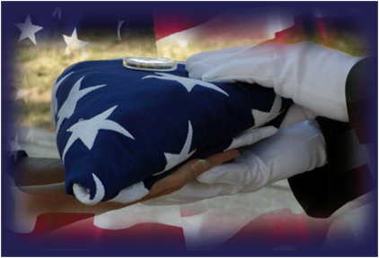
UNCLASSIFIED
Each year from FY13 – FY19, the Navy lost an average of 13 Sailors in off-duty mishaps.
Impact: 13 highly trained, certified, and sworn defenders of this nation are unable to carry on their mission.
Notes:
From FY13-18 the Navy lost an average of 13 Sailors in off-duty mishaps.
That’s 26 less than the number of Service Members lost to on-duty mishaps.
If we continue to take unacceptable risk in our off-duty activities, we can expect to lose another 13 Sailors this fiscal year.
But you can help change that outcome.

Slide 7
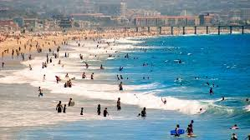
UNCLASSIFIED
SUMMER ACTIVITIES
When you think about summertime you often think about the following:
***FOLLOW STATE AND LOCAL GUIDANCE***
Swimming / Water Parks
Biking
Boating / Jet Skiing
Surfing / Paddle boarding / Kayaking
Diving / Snorkeling
Fishing
Hiking / Jogging
Camping
Sports
Off-road vehicle riding
We are fortunate to live in San Diego County and to have all of these activities available to us. It is your responsibility to ensure that you account for all the risk factors involved in each activity you will be enjoying.

Slide 8

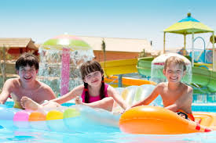
UNCLASSIFIED
SWIMMING
Recognize your limitations
Swim in safe areas
Learn how to handle common water hazards
When required, wear a life jacket
Learn how to swim, float, or tread water
Take a course to learn CPR
Do not participate in water activities while using alcohol or drugs
According to the CDC, the main factors associated with drowning are:
Lack of swimming ability
Lack of barriers
Lack of supervision
Location
Failure to wear life preservers
Alcohol use
Seizure disorders

Slide 9
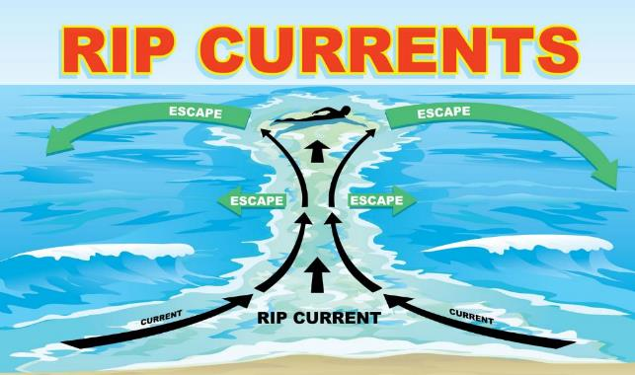
UNCLASSIFIED
Tips to get out of a rip current
Remain calm to conserve energy and think clearly
Never fight against the current
Think of it like a treadmill that cannot be turned off, which you need to step to the side of
Swim out of the current in a direction following the shoreline. When out of the current, swim at an angle--away from the current--towards shore
If you are unable to swim out of the rip current, float or calmly tread water. When out of the current, swim towards shore
If you are still unable to reach shore, draw attention to yourself by waving your arm and yelling for help
Rip currents are powerful, channeled currents of water flowing away from shore. They typically extend from the shoreline, through the surf zone, and past the line of breaking waves. Rip currents can occur at any beach with breaking waves.
Check for current rip current conditions at the National Weather Service website, or local weather forecast report

Slide 10
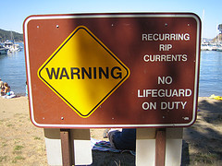
UNCLASSIFIED

Slide 11
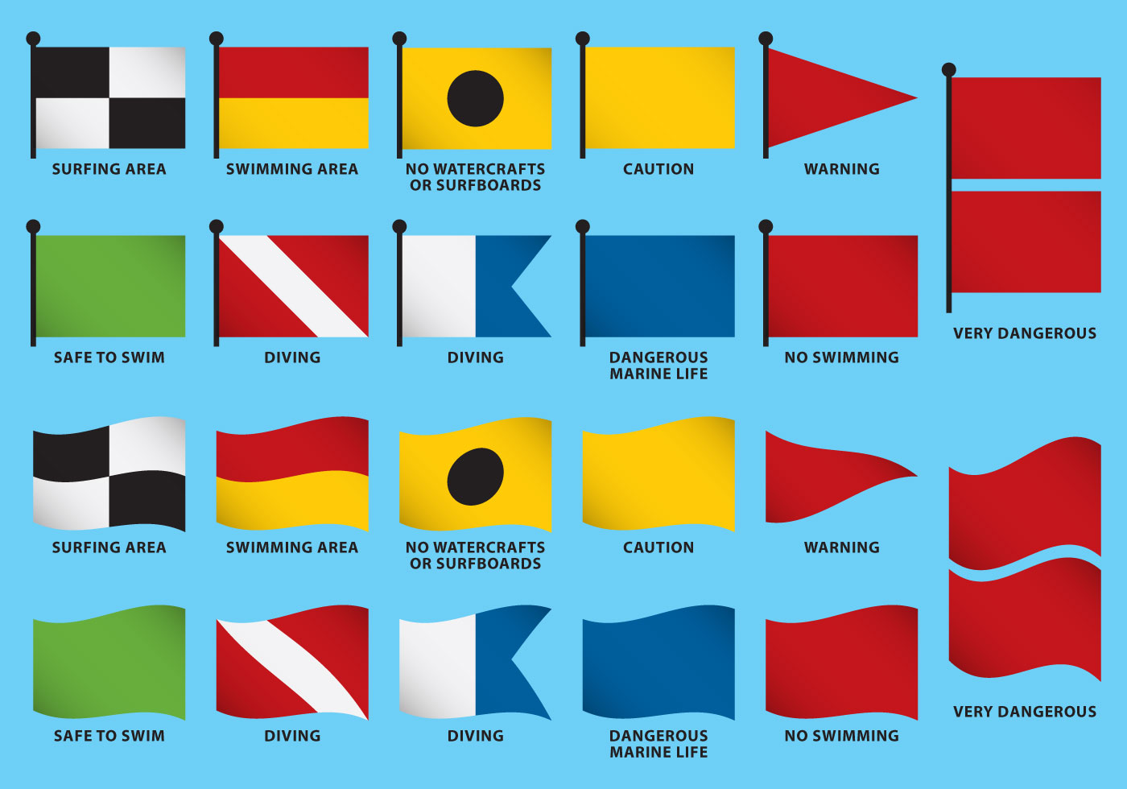
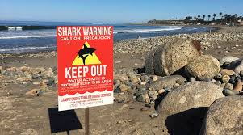

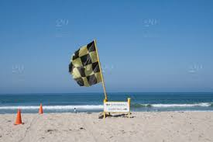
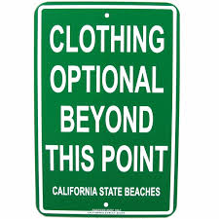
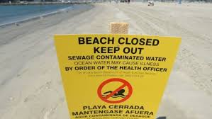
UNCLASSIFIED
Understand the local beach flags and signs for the area you are visiting. Warning signs can change state to state and sometimes county to county.

Slide 12
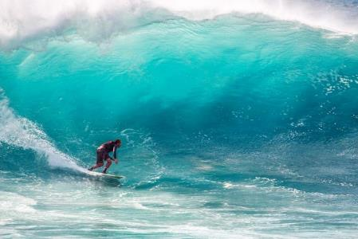
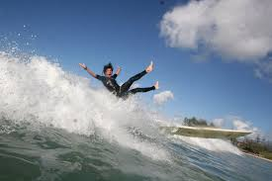
UNCLASSIFIED
SURFING
San Diego County has some of the best surfing in the country. Surfing is a great sport and is inherently dangerous. The very nature of surfing involves its fair share of wipe-outs!
Take lessons before attempting on your own
Never surf alone
Avoid surfing in adverse weather conditions
Ensure your leg rope is attached to your ankle and board
Check to make sure your fins are properly secured
Observe water conditions before entering to ensure it is safe
Maintain a high level of situational awareness because waves are relentless
Pick a point along the beach to line up with and stay in that general area
Always hold on to your board, to prevent it from become a projectile object hurting you or someone else

Slide 13
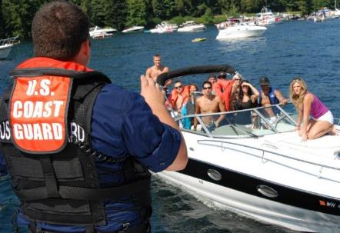
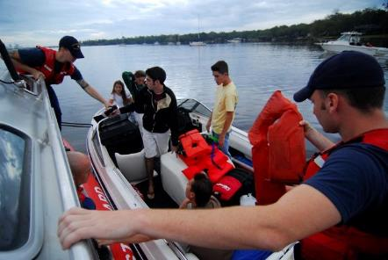
UNCLASSIFIED
BOATING
Each boat operator must abide by federal and state laws governing vessel operation and safety equipment. Also following state and local government COVID-19 guidelines.
Each vessel must be registered within the state, and federally documented by the U.S. Coast Guard
As a passenger, ensure that certain safety equipment is available such as: Life preservers, visual and auditory distress signalers, fire extinguishers, proper ventilation, and navigation lights
Always follow the Rules of the Road
Know that negligent operation is punishable by law, to include: accidents, driving while intoxicated, and failure to comply with navigation rules
Ensure the boat or vessel is tidy and up-to-date on operational maintenance
Always stay alert and keep your eye on the water while on, or operating a boat
Always wear a life preserver while onboard

Slide 14
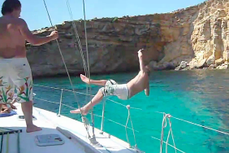
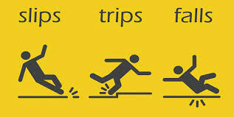
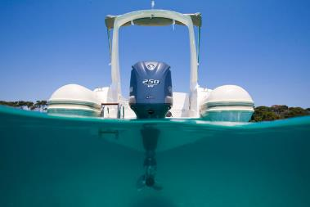
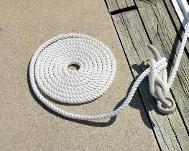
UNCLASSIFIED
BOATING MISHAPS
The most common Boating mishaps include injuries sustained during slips, trips, and falls

Slide 15

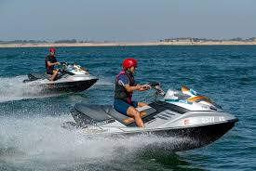
UNCLASSIFIED
JET SKI
Jet Skis are categorized as Class A vessels by the Coast Guard. Therefore all rules and regulations for craft under 16 feet long apply.
Take an operator course before use
Obey the Rules of the Road
Everyone riding on a jet ski should wear a life preserver
Drive defensively, resist dangerous stunts or maneuvers
Key the ignition safety switch lanyard on your wrist or jacket

Slide 16
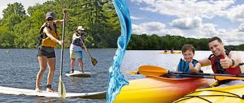
UNCLASSIFIED
PADDLE SPORTS
Whether it’s kayaking, rafting, canoeing, or paddle-boarding, each paddle sport carries its own risk.
Paddle in groups or with a buddy
Train, prepare and use caution on the water
Natural bodies of water are unpredictable and vary in level of risk depending on the weather
Recognize natural obstacles and learn how to navigate them
Always wear a life preserver
Use a paddle or an oar that is sized specifically for you
Dress in breathable layers and wear shoes
Ensure you have the proper gear for the paddling you are doing

Slide 17
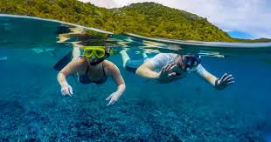
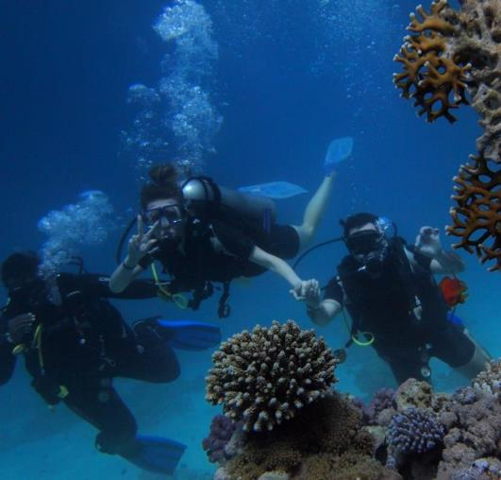
UNCLASSIFIED
Scuba Diving
Take a diving course, and always refresh yourself before each dive
“Plan your dive, dive your plan”
Never dive alone, use the buddy system
Always check your gear before each dive
Always dive in your comfort zone or skill level
Holding your breath underwater can result in serious injury or even death
Take time to establish positive buoyancy first
Practice safe ascents to avoid “the bends”
Pay attention to other divers
Snorkeling:
Never snorkel alone
Know how to clear your mask and snorkel of water
Ensure your face mask and flippers are properly fitted
Stay fit, snorkeling requires the ability to swim and float. Stamina and endurance is a main component to a positive experience
Stay close to the shoreline identify entry and exit points to the water, in case you become too tired to swim back
Always check the weather forecast and sea conditions before entering the surf
Remember to apply (and reapply) sun screen

Slide 18




UNCLASSIFIED
RECREATIONAL WATER ILLNESS
Norovirus
RWI’s are most commonly acquired from water based activities involving pools, water parks, interactive fountains, lakes rivers, and oceans
Common RWI infections include:
Diarrhea
Rash
Ear Infection
Respiratory infection
Chemical irritation of the eyes and lungs
chryptosporidium
Naegleria Foweri ameba
e. Coli
Rare cases of a brain tissue eating amoeba called “naegleria foweri” can be found in fresh water bodies. The amoeba enters the body through the nose. You cannot get infected from drinking contaminated water.
“Chrypto” can stay alive for days in a chlorine environment and has become the leading cause for pool-related outbreaks (according to the Center for Disease Control)
Diarrhea is the most common symptom of a RWI, which is caused from germs such as:
Norovirus
Giardia
Shigella
E-coli
Chryptosporidium

Slide 19
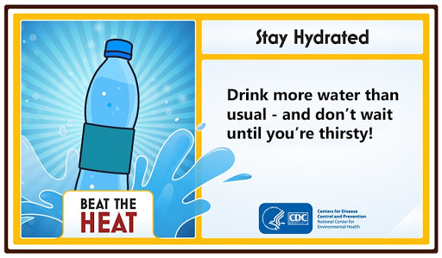
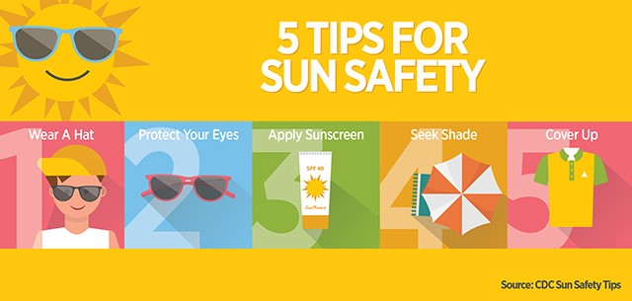
UNCLASSIFIED
Water is the single most important nutrient for health, growth, and development; it is critical to the balance of all the body's systems, including the brain, heart, lungs, kidneys and muscles. Mild dehydration is a common cause of daytime fatigue. An estimated 75 percent of Americans have mild, chronic dehydration. Experts recommend that the average person drink 8 to 12 cups of water per day. Avoid fruit juices, carbohydrate gels, sodas, alcohol, and high sugar sports drinks. These drinks can dehydrate the body by stimulating excess urine production and/or decreasing voluntary fluid intake.

Slide 20
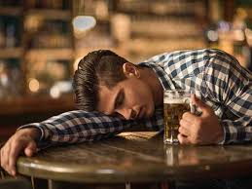
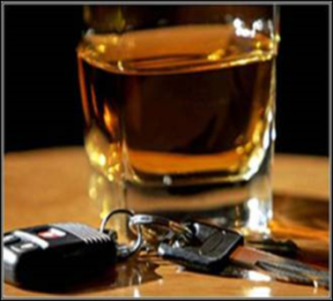
UNCLASSIFIED
ALCOHOL
Don’t Drink & Drive
Impaired Judgment
+
Poor vision
+
Delayed/Slow Reaction Time
=
MISHAP
Notes:
As you will see throughout this presentation, alcohol is common denominator in off-duty mishaps. Since FY14, there have been nearly 78 off-duty mishaps in the Navy where alcohol use was confirmed or suspected. Alcohol consumption slows your reaction time and, as you are all well aware, impair both your judgement and your vision. All these factors can lead to a mishap.
Most alcohol-related mishaps involve private motor vehicles, both the two-wheeled and four-wheel variety. Each year Naval personnel die while handling weapons, boating, swimming, fishing, and participating in other activities while consuming alcohol. We are going to take a look at each activity that often results in off-duty fatalities. Let’s begin with water-related activities.

Slide 21

UNCLASSIFIED
SOCIAL DRINKING
Socializing itself is not a risky behavior, however, anytime people gather with alcohol available some are going to drink enough to impair their judgement. Accidents can happen while socializing frequently because of alcohol consumption.
** *DON’T FORGET TO SOCIAL DISTANCE ***
The main cause of accidents while socializing are:
Excessive drinking
Participating in activities with impaired judgement and skill set.
What can you do to prevent accidents while socializing?
Make sure you have non-alcoholic beverages available at social events.
Limit the number of alcoholic drinks.
Have a plan and… DO NOT DRINK & DRIVE.
Plan or participate in activities that will not be dangerous to those impaired by alcohol.

Slide 22

UNCLASSIFIED
DISTRACTED DRIVING
Distracted driving: anything that takes your attention away or diverts attention from the task of safe driving.
talking or texting on your phone
eating and drinking
talking to people in your vehicle
fiddling with the stereo, entertainment or navigation system—anything (including emotional distress)
Texting is the most alarming distraction :
5 seconds driving at 55 mph = driving an entire football field with your eyes closed.
Do not drive unless the task of
driving has your full attention.
Any non-driving activity you engage in
is a potential distraction and increases your
risk of crashing.
Notes:
To prevent tragedies due to distracted driving, motorists are urged to:
•Turn off electronic devices and put them out of reach before starting to drive.
•Be good role models for young drivers and set a good example. Talk with your teens about responsible driving.
•Speak up when you are a passenger and your driver uses an electronic device while driving. Offer to make the call for the driver, so his or her full attention stays on the driving task.
•Always wear your seat belt. Seat belts are the best defense against unsafe drivers.
Currently, 47 states, DC, Puerto Rico, Guam, and the U.S. Virgin Islands ban text messaging for all drivers. All but four have primary enforcement laws - an officer may cite a driver for using a hand-held cell phone without any other traffic offense taking place and be given a fine. Fifteen states, DC, Puerto Rico, Guam, and the U.S. Virgin Islands prohibit all drivers from using hand-held cell phones while driving. Important to note: 38 states and DC ban all cell phone use by novice drivers, and 20 states and DC prohibit it for school bus drivers.
Sources: https://www.nhtsa.gov/risky-driving/distracted-driving

Slide 23

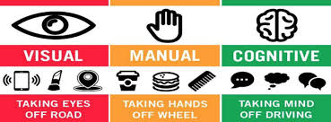
UNCLASSIFIED
According to the National Highway Transportation Safety Administration:
Distracted driving is dangerous, claiming 2,841 lives in 2018 alone. Among those killed: 1,730 drivers, 605 passengers, 400 pedestrians and 77 bicyclists.
400,000. The estimate of people injured in crashes involving distracted drivers in 2018.
Notes:
In 2016, new NHTSA data shows that at least 3,450 people were killed in motor vehicle crashes involving distracted drivers, including those who were texting and driving. Key statistical findings in NHTSA’s new 2016 Distracted Driving Research Note and Teen Distracted Driver Fact Sheet include:
•Nine percent of fatal crashes in 2016 were reported as distraction-affected crashes.
•Six percent of all drivers involved in fatal crashes were reported as distracted at the time of the crash.
•Nine percent of drivers 15 to 19 years old involved in fatal crashes were reported as distracted. This age group has the largest proportion of drivers who were distracted at the times of the fatal crashes.
•In 2016, there were 562 non-occupants (pedestrians, bicyclists, and others) killed in distraction-affected crashes.
•In 2016, 70 percent of the distracted drivers in fatal crashes were male, as compared to 74 percent of drivers in all fatal crashes.
•Hand-held cell phone use while driving is highest among 15- to 29-year-old drivers.
•Female drivers with a cell phone have been more likely to be involved in fatal distracted-driving crashes as compared to male drivers every year since 2012.
Sources: https://www.nhtsa.gov/press-releases/us-dot-and-nhtsa-kick-5th-annual-u-drive-u-text-u-pay-campaign

Slide 24
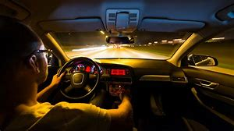

UNCLASSIFIED
DRIVING FATIGUE
Start every trip well-rested.
Drive during daylight hours if possible.
Schedule breaks each two hours
Never drink and drive.
Pull over if you get tired.
TRiPS: driving planning tool to reinforce skills, such as staying alert, getting adequate sleep, etc. (https://trips.safety.army.mil/TRiPS)
Notes:
Always plan ahead prior to travel and consider the weather, road conditions, and traffic as factors when traveling.
All these conditions impact your ability to fight fatigue as well as it may take longer than you thought to arrive at your destination.

Slide 25
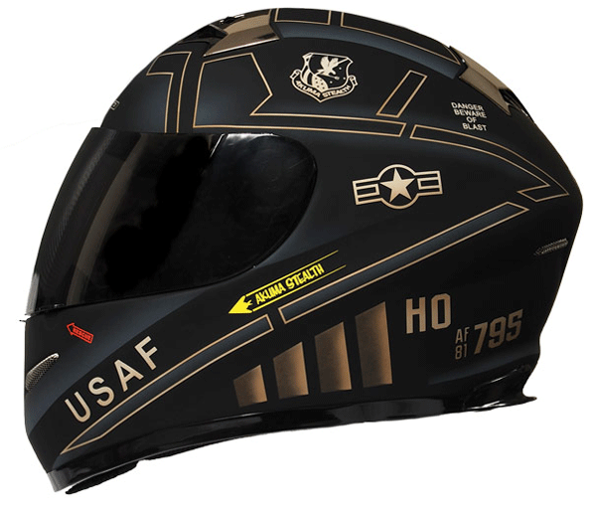
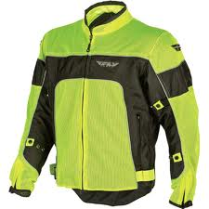
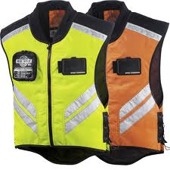
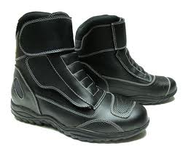
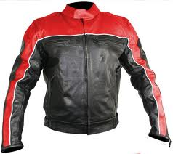
UNCLASSIFIED
MOTORCYCLE RIDER PPE
Head Protection: DOT Approved Helmet / Novelty Helmets are not authorized
Eye Protection: wrap around glasses/goggles
Protective Clothing:
-Long sleeved shirt/jacket
-Long trousers
-Full-fingered gloves
Foot Protection: Sturdy over-the-ankle boots.
Clothing Visibility (Highly Recommended):
Daytime: upper garments that incorporate high visibility
Night: retro reflective upper garment
Notes:
If you are military you must comply with AFI91-207 at all times, on and off base!

Slide 26
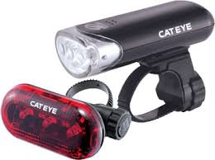
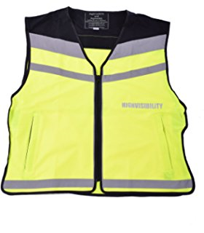
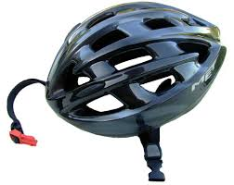
UNCLASSIFIED
BICYCLE
NAVBASESANDIEGOINST 5450.8R
576. REGULATIONS FOR BICYCLES (Page 5-42)
Bicycle operators riding on a NRSW installation roadway shall ride with traffic, in single file, obeying traffic rules while properly wearing brightly colored reflective clothing between sunset and sunrise and a bicycle helmet approved by the Consumer product Safety Commission or Snell Memorial Foundation at all times.

Slide 27

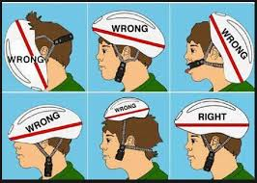
UNCLASSIFIED
NBSD Bicycle Regulations:
Wear bicycle helmets always approved by the
Consumer product Safety Commission or Snell Memorial Foundation
During hours of darkness have white lamp on the front being visible from a distance of at least 500 feet, and a red light on the rear that visible at least 600 feet are required. Lights may be steady burning or blinking.
Wear brightly colored reflective clothing between sunset and sunrise.

Slide 28
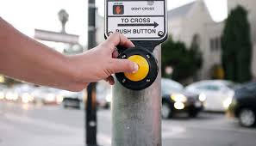

UNCLASSIFIED
PEDESTRIAN
As a reminder to personnel conducting PT; wear bright color clothing or utilize reflective vests in which increase driver awareness.
Pedestrians should always use designated intersections and crosswalks (Don’t “Jay Walk!”).
Look both ways before you cross the street.
Use caution while transiting in parking lots and garages due to reduced visibility.
Make “eye contact” with drivers to ensure they see you before crossing. Don’t “text and walk”!

Slide 29
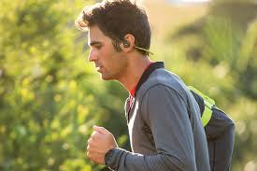
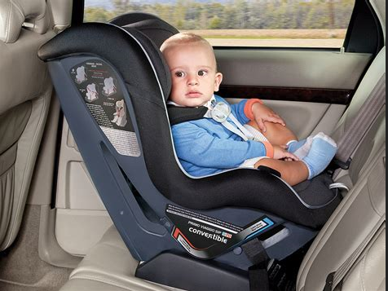
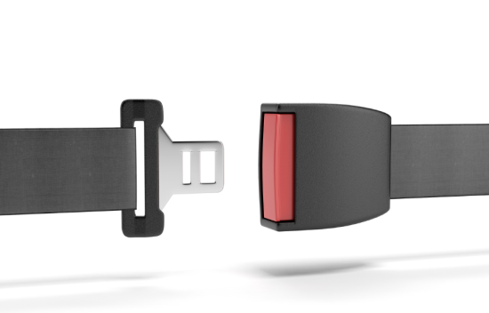
UNCLASSIFIED
TRAFFIC SAFETY INFORMATION
The use of “ear-buds” / “headphones” while walking and running in the roadways on Naval Base San Diego is not authorized. Their use is authorized at designated track fields, gyms, and while on the sidewalk (but not while in/or crossing the roadway).
Seat Belts: required while operating and riding in a motor vehicle (i.e. automobile, golf carts, forklifts, etc.).
Child Safety Seat Law: In addition to the existing child passenger restraint system laws, any child who is under 2 years old must be secured in a rear-facing child passenger restraint system unless the child is 40 pounds or more, or 3’3” or taller. (verify expiration date and replace if expired/or involved in an accident)
Helmets (Snell or Consumer Product Safety Board approved) are required when riding a motorcycle or bicycle.

Slide 30

UNCLASSIFIED
SAPR
The Department of Defense Sexual Assault Prevention and Response Office (SAPRO) promotes military readiness by eliminating sexual assault and ensuring excellence in victim advocacy and prevention efforts through the execution of SAPR policy, planning, and oversight across the DoD Community.

Slide 31
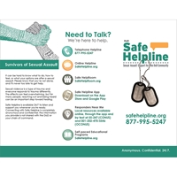
UNCLASSIFIED
SAPR SAFE HELPLINE
What is DoD Safe Helpline?
DoD Safe Helpline is a secure, confidential, and anonymous crisis support service specially designed for members of the DoD community affected by sexual assault. Safe Helpline is available 24/7, worldwide. Safe Helpline staff provides live, one-on-one support to survivors, their families, and other DoD stakeholders. All Safe Helpline services are secure, confidential, anonymous, and available worldwide, providing survivors with the help they need, anytime, anywhere.

Slide 32
UNCLASSIFIED
Faith, Courage, Service true, with Honor, Over Honor, Over All
Be safe!

